Slide 1



Alex Summer Dennis Crenshaw David Williams Avery Scott
“Software reverse engineering involves taking an existing system for which source code or proper documentation is not available and attempting to recover details regarding its design and implementation.”
Eldad Eilam
http://www.highrely.com/assets/Software_Test_Web.jpg

Slide 2

Integration of legacy systems with new technology
Lost documentation or source code
Corporate competition
Interoperability of heterogeneous software systems
To gain knowledge and understanding of the process of software engineering

Slide 3








Slide 4

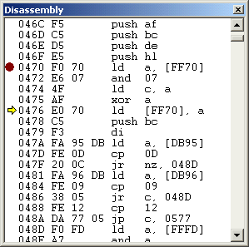
Decompilation
  Map binary code to a high-level language
Disassembly
  Map binary code to assembly language
Clean room design
  Black box approach
http://gamelad.emuunlim.com/gamelad/disassembly.gif

Slide 5

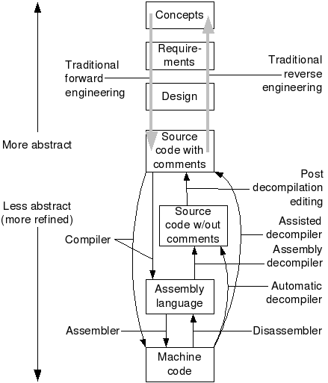
http://www.program-transformation.org/pub/Transform/DecompilationAndReverseEngineering/decompOverview6.png

Slide 6


Interactive Disassembler (IDA)
  Utilize developer input to aid disassembly
Logic Analyzer
  Viewing software processes at the hardware level
Specific Tools
  dbg, OllyDbg

Slide 7


Obfuscation
  Purposely over complicating source code
Code Morphing
  Translating to an intermediate language
Digital Rights Management (DRM)
  Media encryption incorporated into hardware
http://davidbrunelle.com/files/2007/03/padlock.jpg

Slide 8

Contract law
  End user license agreement (EULA)
Copyright law
  Reverse engineering the code constitutes an unauthorized copy
Software Patents
  Untested in court
  May prove to be a legal stumbling block

Slide 9

“Copies of software should be made only with proper authorization. Unauthorized duplication of materials must not be condoned.”
“…compliance must be balanced with the recognition that sometimes existing laws and rules may be immoral or inappropriate and, therefore, must be challenged.”
ACM – Code of Ethics

